Slide 1
OSDU – an introduction

Slide 2
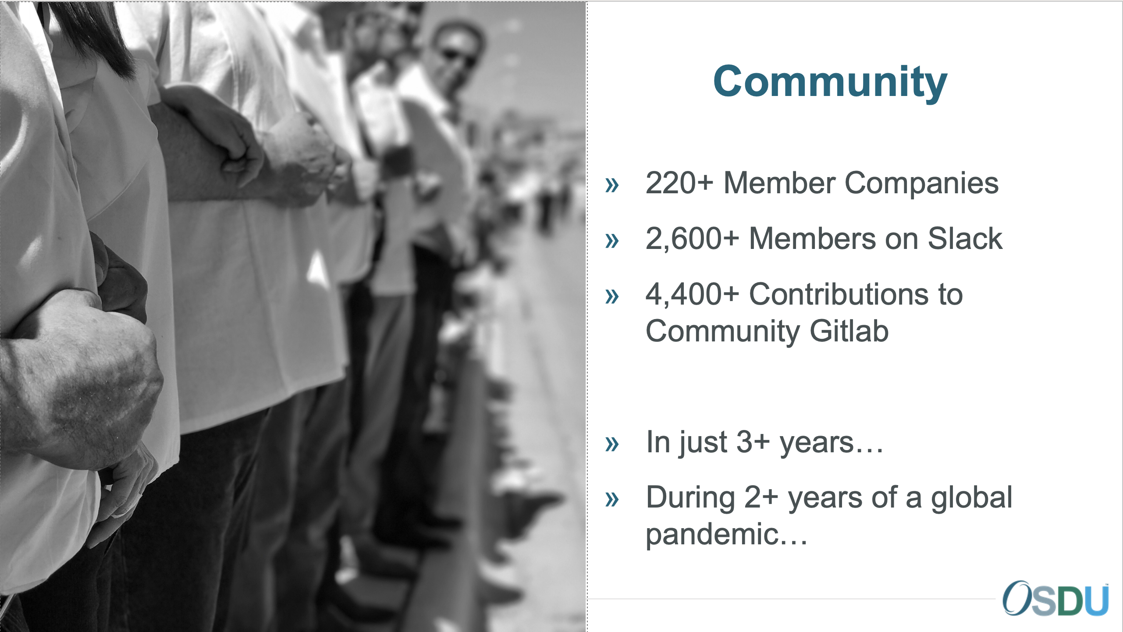
What is the OSDU Forum
Cross industry effort
Open Source Software Project
Prosperous and growing community
Data Platform initiative to achieve
Interoperability and accelerate innovation
A long-term goal to drive down costs
A pathway for a cloud-native migration
Serves, but not restricted to the subsurface
Continuously delivering new version and capabilities.
Very good involvement and increased adaption from operators, service/solution providers and cloud service providers.
The OSDU Forum Mission:
The Open Group OSDU Forum delivers an Open Source, standards-based, technology-agnostic data platform for the energy industry that stimulates innovation, industrialize data management, and reduced time to market for new solutions.
Equinor a founding member

Slide 3

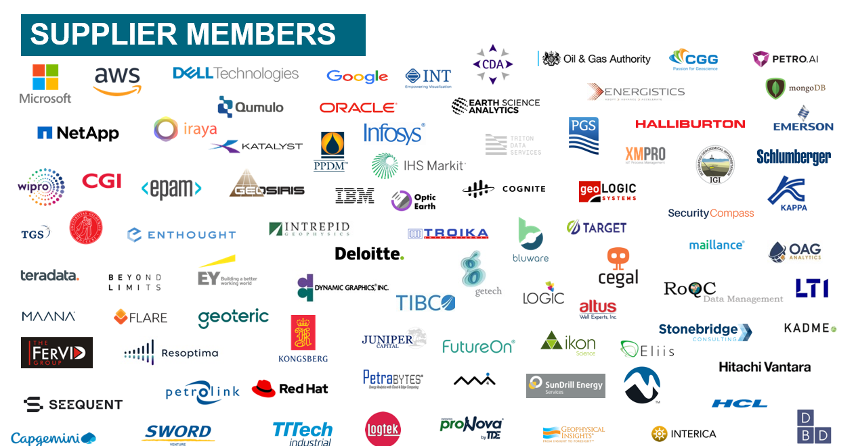
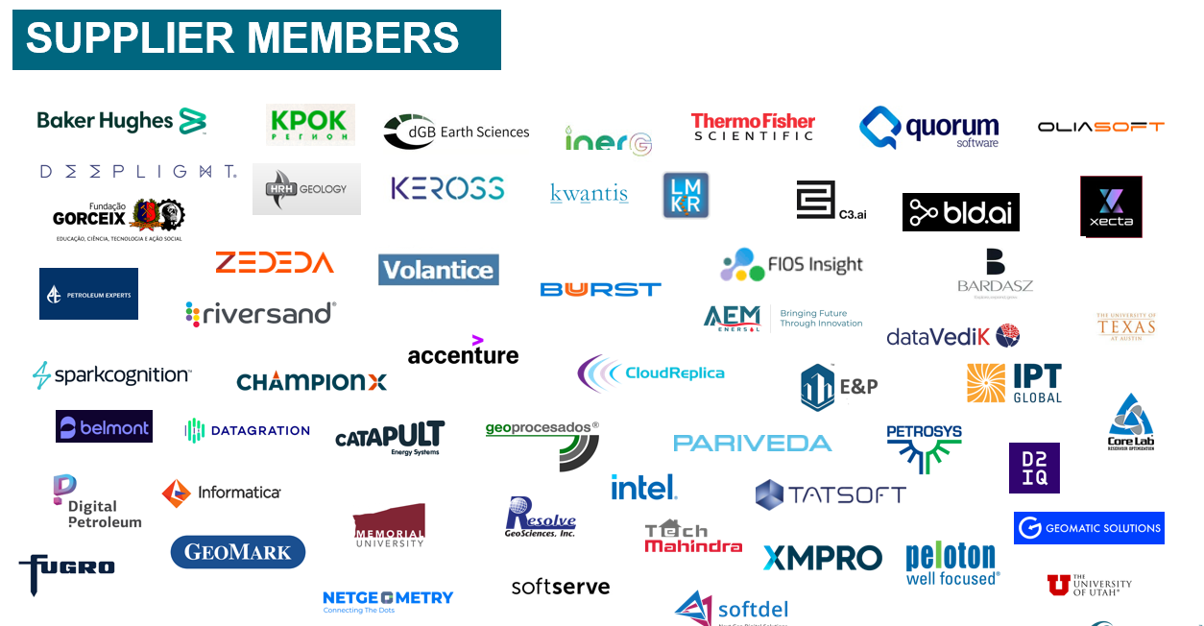
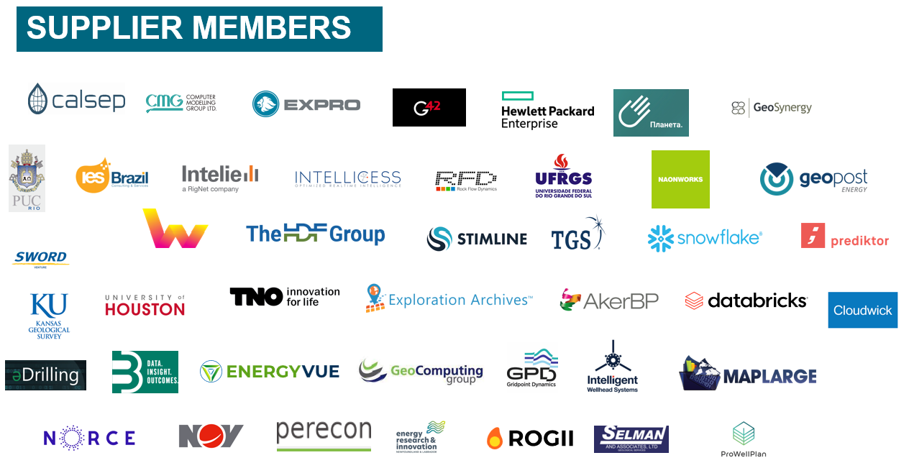
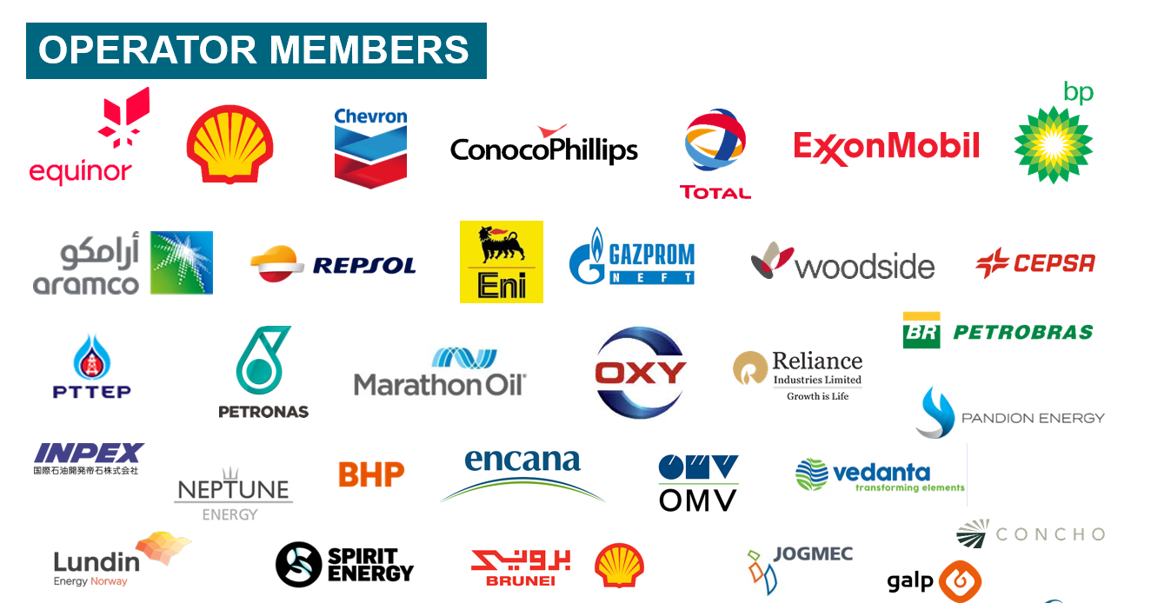
The Open Group OSDU Forum was founded in H2 2018 and the membership as of now consists of:
30+ operators
175+ oilfield services & software companies
10+ academic institutions
4+ cloud services providers

Slide 4
ORGANIZATION
The Open Group
The Open Group works with customers and suppliers of technology products and services, and with consortia and other standards organizations to capture, clarify, and integrate current and emerging requirements, establish standards and policies, and share best practices. The Open Group OSDU Forum Management Team ensures openness of discussion, interoperability of forum work products, no legal impediment to implementation, confidentiality of deliberations, and consensus driven decision making.
Program Director: Dennis Stevens
Associate Forum Director & Forum Support: Amanda Bonin
Focal Points
The Focal Points are led by a Chair and Vice Char and have representatives of all Member companies responsible for strategic decision making and voting on OSDU Forum matters and representing their organizations interest.
Focal points can be contacted through Slack, and the full list can be accessed here.
Forum Chair: Patrick Kelly (Chevron)
Forum Vice Chair: Jane McConnell
OSDU Management Committee (OMC)
The OMC is the 11-member tactical decision-making committee elected by the OSDU Member Focal Points to oversee the OSDU Forum.
Shared Backlog - AHA
The Shared Backlog contains all Open Source, Community, and Forum projects chartered as aligned to Capabilities. This allows for transparency and alignment of the roadmap, priorities, and progress. It also provides for ticketing of Bugs, Questions, Changes, and Ideas.
Working Groups
Working groups are established to enable collaborative definition of requirements, standards, practices, priority, roadmap, community alignment and progress toward platform and forum goals.
Project Management Committee (PMC)
The PMC governs software projects contributing to the development of the OSDU Data Platform under an Open-Source Model.

Slide 5
What is the OSDU Forum Creating?
OSDU Data Platform
OSDU Data Concepts
Data ingestion, storage, search, and consumption.
Open-Source software with published APIs and Domain Data models
Support for versioning, lineage and provenance.
Hosted on agnostic cloud infrastructure
Available on Microsoft Azure, Amazon AWS, IBM, Google GCP and others
Can be hosted on internal IT infrastructure
Mandate to define main data specifications for the Data Catalog (“Core Services”).
Datatype footprint definition
Datatype name, description, group-type.
Attribute based schemas (name, type, description,…)
Agreed file format - if any
Set the contextual Reference data (type, governance, values,…)
Progressively moving to “Data Concepts” – engaging with PMC to assist “Projects”
Ensuring the coherency of the catalog - “Body of Knowledge” – joining the dots.
Bringing people (SMEs and Architect) to support Projects – and DDMS “Content” models.

Slide 6
OSDU Data Platform

Slide 7
System Design Principles
Agility
Take a user centric approach
Microservices architecture
Aligned autonomous teams
Continuous delivery and feedback
Security
Make security everybody’s concern
Leverage cloud provider expertise
Protect data as the most valuable asset
Put customer in control of data and users
DevOps
Minimize impact to operational instances
Monitor everything important to the user
Favor managed offerings
Use robust and fault tolerant patterns
Automate at every step
Focus on few languages and frameworks
Poly Cloud
Avoid the least common denominator
Adopt community (Open Source) APIs, or develop SPI to ease portability

Slide 8
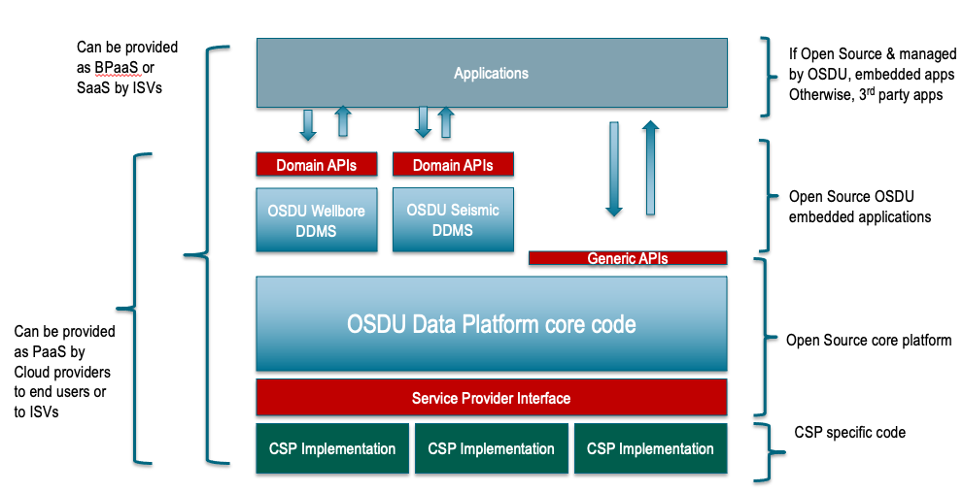
OSDU Data Platform Software Components

Slide 9
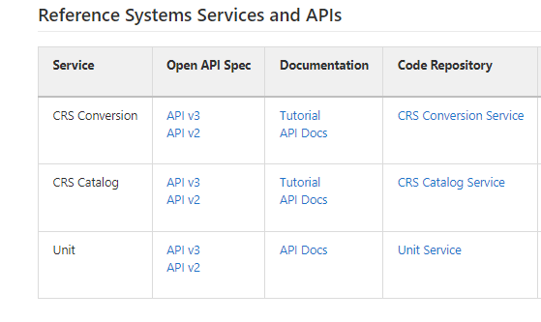
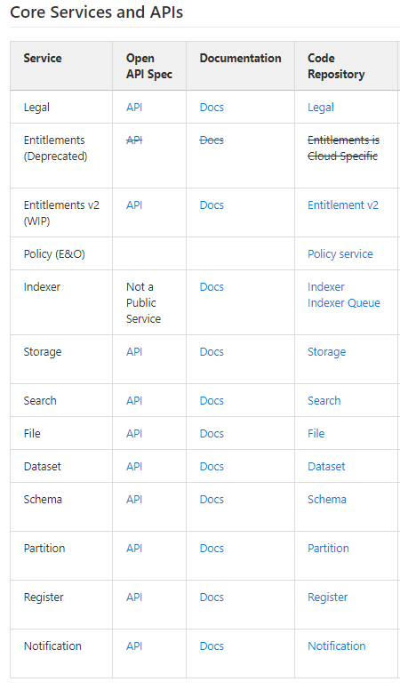
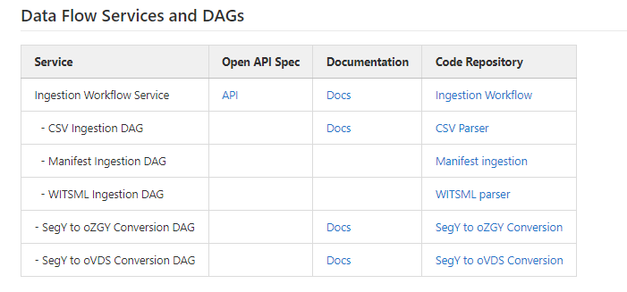
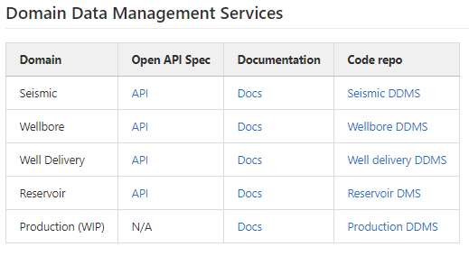
OSDU APIs
High level

Slide 10
OSDU Data Concepts

Slide 11
Data principles
We value all data
Minimize friction on Data Loading and Ingestion
Don’t forget what you already know
All raw data is preserved
Data are immutable
We use data securely and responsibly
Data are access controlled
Data are governed for right of use
Data has a clear ownership
We embrace minimal viable governance
Data are globally identifiable
Data are discoverable
Data are consumable
We establish, monitor and continuously improve the quality of data
Optimize schema and quality on consumption
Improved data are new data
Data lineage is tracked

Slide 12
Working Group Structure
Core Concepts
PPDM Integration & Reference Data
Test Data
Documents
Geochemistry
Petrophysics
CCS
Production
Reservoir Modeling
Reservoir Management
Renewables
Well Delivery
Seismic

Slide 13
OSDU group type
Master Data
Work Product Component
Reference Data
Work Product
Dataset
Section 2, OSDU Schema Usage Guide
Demystifying Well Known Schema/Entity
Notes:
Data type proposals must be assigned an OSDU group type, and the group type dictates the degree of specificity and comprehensiveness needed for the definition
These are the primary group types for data modelling activity

Slide 14
“What’s in it for me…”

Slide 15

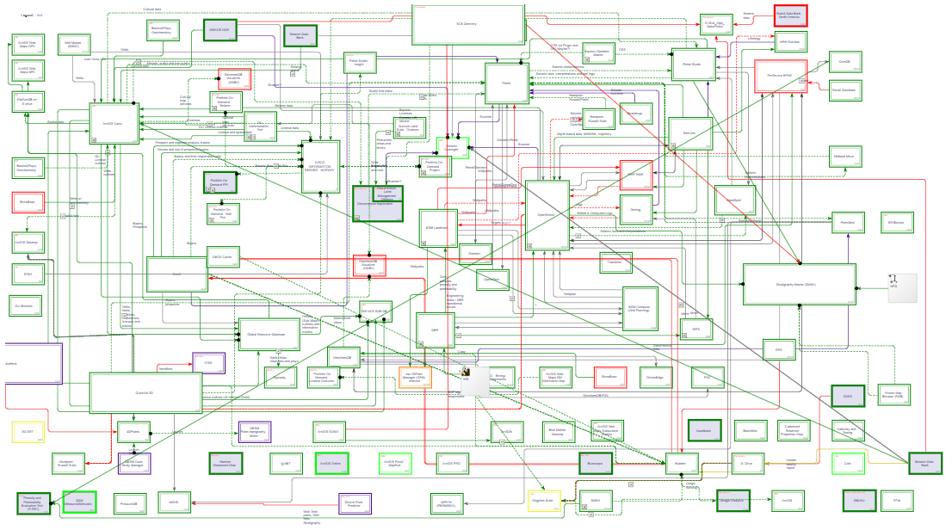
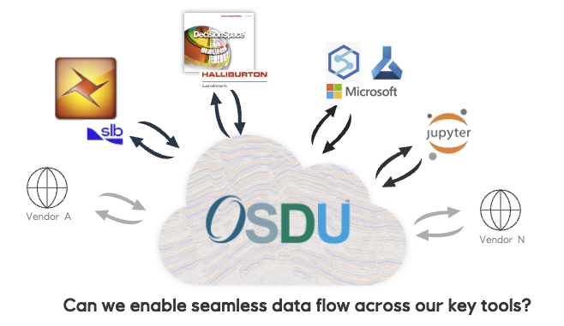
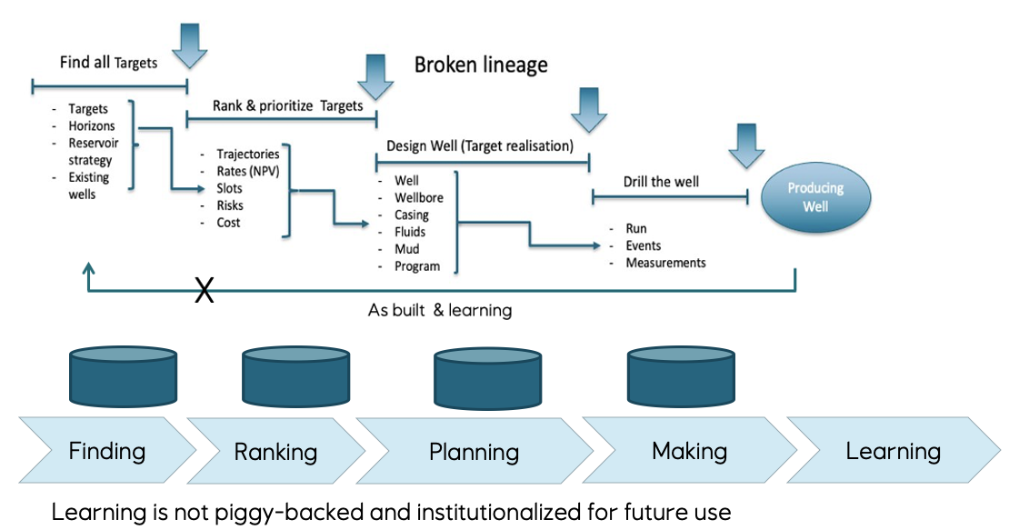
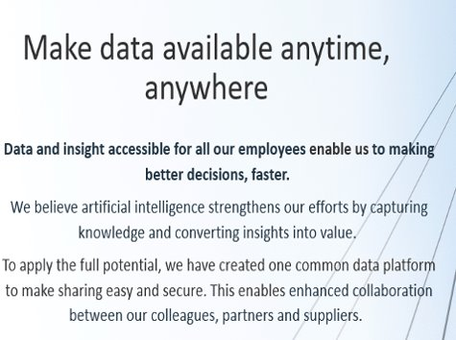
Drivers for OSDU
Boost innovation
Minimize data “locked” in functional silos
Interoperability
Digitalisation require data with known quality
Lack of lineage and provenance
Data needs curation to be valuable
Avoid information loss
Common catalogue and access to data
None can do it alone
Enable industrial automation
Sharing infrastructure development cost
Industrial standardisation
To address

Slide 16
From platform development to solution integration – relative effort
Early days dominated by platform
As the platform become usable, a growing set of solutions emerge
Approaching inflection point where solution development overtake platform
Solution space development will change from creating point solutions to workflow composition and system integration
OSDU Data Platform
OSDU adaption and enabled business solutions
2019
2023

Slide 17
What does it take?
OSDU Success =
Alignment, transparency and
co-operation
OSDU Community
Vendors
Equinor
Key observations:
There must be a joint situational perspective for the area to standardize.
There must be assumed business opportunities in several dimensions for this to work.
E.g. Operators, Service/SW providers and cloud providers.
Transparency and openness within forum is a make or break
Operators (as main customers) involvement and contributions in the OSDU community is key.
Equinor very active in OSDU Community.
OSDU Sponsors: Harald Laastad & Oddvar Vermedal
OSDU Advisory Group: Harald Laastad & Oddvar Vermedal
Equinor focal-point: Einar Landre
OSDU Management Committee: Equinor (Øivind Berggraf) ,TotalEnergie, Shell, BP, XON,
OSDU Chair: Chevron
5-10 resources continuously involved in different parts of community. Spans SMEs, Data engineers, SW architects and others from different parts of Equinor.
Operators like Equinor needs to have focus on developing the new market and from time to time seed fund application and service vendors.
OSDU is a key strategic bet in Equinor´s digitalization and cloud journey
Equinor have an internal OSDU DevOps team (8-10 persons) continuously working on utilising OSDU in Equinor.

Slide 18
The OSDU journey
2022 and beyond
Increased commercial solution focus: Cloud Service and app/solution providers.
Continuous development of new OSDU capabilities.
Seismic, Wells, Reservoir, Rock & Fluid, Production, Real-time, New Energy, ….
Initial operational deployments in many O&G companies.
Equinor, ExxonMobil, Shell, Chevron, TotalEnergie, BP, Petrobras, WinterShall DEA, …
2020-2021:
OSDU Mercury – development of first commercial release.
Implemented on Microsoft, AWS, Google and IBM/RedHat
2018-2019:
Shell invites O&G companies to join forces to drive the development of an Open Source Data Platform for Upstream O&G and donates Shell Data Universe (SDU) code as a kick start.
OSDU founded in September 2018 as an Open Group Forum. Many ISV’s and tech companies joins and new are still joining
July 2019: SLB donates DELFI data services. Refactoring Shell+SLB code really kicks-off.
– 2017:
Increased focus on digitalisation, data and new value from data
O&G cloud transition begins.

Slide 19
Questions?

